Slide 1
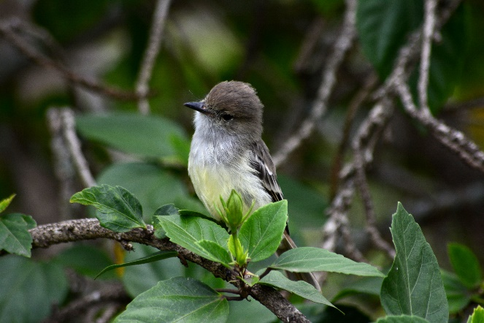
7-11
CLASSIFICATION CALAMITY! LESSON PLAN
 |  | FUTURE LEARNING: Students could use the Galapagos wildlife page on the GCT website to choose their own Galapagos species to classify, for example, invertebrates, mammals or reptiles.
This activity builds on previous knowledge of devising simple keys and extends learning to produce more complex classification keys.
LEARNING OBJECTIVES:
Science: Describe how living things (i.e. plants and animals) are classified into groups according to common observable characteristics and based on similarities and differences.
STUDENTS’ OUTCOMES: To give reasons for classifying plants and animals based on specific characteristics.
KEY VOCABULARY:
Classification, taxonomy, key,
RESOURCES REQUIRED:
Internet access for link
Species classification handout
Example of a key handout
Bird species of the Galapagos handout
Galapagos wildlife web page
FIRE STARTER: Begin by reviewing classification and using taxonomic keys using species classification handout. Look at the example of a key handout if required.
Explain to students that during the Voyage of the Beagle, Darwin collected the following – Over 500 specimens, over ½ were plants and duplicates, including 65 birds, 40 rocks, 15 reptiles, 15 fish, 17 land snails, 13 insects (total 85 arthropods) seashells & several marine invertebrates!
During his time on board and on his return home, Darwin began classifying the specimens he had collected. He had help from scientists who were specialists in their field.
GAINING GROUND:
Hand out the bird species cards. Explain that the cards are mixed up and need classifying again. Can they design a key to classify each bird species? Working individually or with learning partners, complete task. Discuss and compare questions they used to separate and classify individual species. Which were easier or trickier to classify and why?
©Sarah Langford
AUTHOR?
[notes]
_______________________________________________________________________________________
A RESOURCE BROUGHT TO YOU BY GALAPAGOS CONSERVATION TRUST (REGISTERED CHARITY NO. 1043470) AND THE ROYAL GEOGRAPHICAL SOCIETY (WITH IBG)

