Slide 1
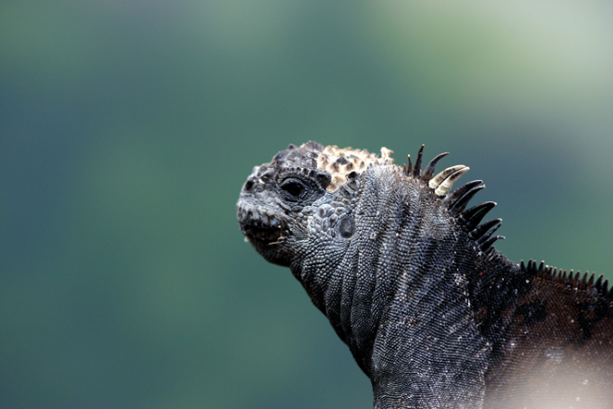
7-11
AMAZING ADAPTATIONS LESSON PLAN
This activity takes students through how iguanas colonised the islands to how the marine and land iguanas diverged to become different species. The amazing adaptations of the marine iguana will be revealed!
LEARNING OBJECTIVES:
Science: to identify how animals are adapted to suit their environment in different ways and that adaptation may lead to evolution. Identify different categories of adaptation.
STUDENTS’ OUTCOMES: To understand the term adaptation and how the marine iguana adapted and evolved to a new environment. Explain and categorise adaptations of the marine iguana.
KEY VOCABULARY: adaptation, habitat, environment, conditions, evolve, structural, physiological, behavioural
RESOURCES REQUIRED:
Amazing adaptations PowerPoint
Amazing adaptations question cards
Amazing adaptations answer cards
FIRE STARTER: Begin by discussing what the term adaptation means. Students can discuss with learning partners and share their definitions. Can they give examples of how animals are adapted to different environments? The powerpoint presentation begins by going back in time to show the ancestor of the marine iguana, where it came from, what it looked like and its habitat.
On Slide 5 students are introduced to how the iguanas colonised the Galapagos and asked to think of challenges they faced on arriving. Slide 7 explains how the iguanas adapted and changed over time to become the marine iguanas of today that are now widespread among the islands.
GAINING GROUND:
Using slides 8-13 and/or photo question cards, ask students to think about the questions posed on each slide picture/card about how the marine iguana is adapted to its environment.
You may want to hand out answer cards that explain the answers or just discuss students’ ideas.
Great explanation of their evolution by David Attenborough in this link.
 |  | FUTURE LEARNING: Slide 14 and 15 extends learning to explain different types of adaptation (i.e. structural, physiological and behavioural) and asks students to categorise the traits of the iguana just studied. It also promotes further discussion into why the iguanas are black in colour. A fun activity that will take a few lessons and allows students to consider what it would be like to be marooned on a desert island and have to plan carefully in order to survive can be found at the following link – http://www.sitesalive.com/oil/tg/private/oiltgsurvival.html Further video footage of iguanas can be found here
AUTHOR?
A RESOURCE BROUGHT TO YOU BY GALAPAGOS CONSERVATION TRUST (REGISTERED CHARITY NO. 1043470)
GALAPAGOSCONSERVATION.ORG.UK

