Slide 1
Be a blood scientist – Analysing tortoise blood cells

Slide 2
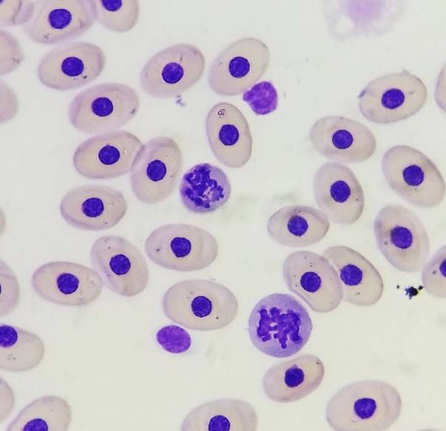
Look at the following blood sample taken from a Galapagos giant tortoise.
These are red blood cells.
Compared to some other species they are large so are counted manually using a special counter.
Have you noticed the cell is an oval shape and the nucleus inside is too?
Mammalian blood cells don’t have a nucleus like the ones you can see here – bird and reptile species do!
How many red blood cells can you count in this sample?
Smaller numbers of red blood cells means the animal has anaemia.
Ignore the cells that look slightly different.
Images © Ainoa Nieta Claudin
Top - Modified Wright-Giemsa-stained peripheral blood from San Cristobal (Chelonoidis chathamensis)
Bottom - Modified Wright-Giemsa-stained peripheral blood from Española (Chelonoidis hoodensis)

Slide 3
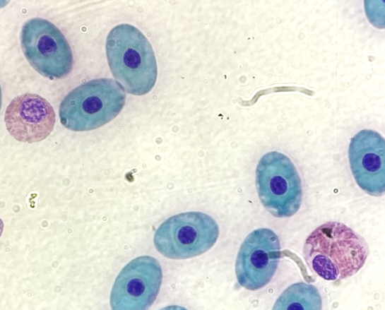
Blood cells known as white blood cells can be seen in blood. These cells can help fight disease and infection. They increase in number if there is an infection.
Can you see this heterophil? The white blood cells make this to help fight disease or infection.
They can usually be seen in the first few weeks of infection or illness and so help the scientists find out if the tortoise is ill.
Can you spot the heterophil in this sample?
Images © Ainoa Nieta Claudin – Modified Wright-Giemsa-stained peripheral blood from Española (Chelonoidis hoodensis)

Slide 4
Other cells can be identified to help analyse the health of a tortoise. This eosinophil is a kind of white blood cell that helps fight disease.
Would you like to be a tortoise health scientist and learn more about tortoise health?
Image © Ainoa Nieta Claudin
Modified Wright-Giemsa-stained peripheral blood from San Cristobal (Chelonoidis chathamensis)

